Slide 1
Tips and tricks on data and public records
Jill Castellano
8.23.17

Slide 2
Three things
Formulating the best public records request
Organizing your data with the right file types and formats
Learning basic web scraping (without coding)
Notes:
1: The key: get over obstacles to getting the information you want

Slide 3
How to get the records you want
Tip 1: Call first
First, call the public agency and say, “I’m trying to understand how this works”
Are they indicating to you that they track something?
Make a request to get what they have while on the phone
Writing your request: “As discussed on the phone with an employee of your agency”
Notes:
Have a document/data set of mind. Talk to someone on the phone at the agency and keep out for language that
If you can, talk to somebody at the agency first. It’s much better to talk to somebody in the IT department (if it’s data) or try to get past the PR person if you can, somebody who understands what you’re doing. IT people are the most overlooked people in any organization. You should be the person who actually understands them! Be interested in what they do and it’ll go a long way.
Make someone walk you through what they do rather than call and ask for information. Say something like “help me understand what you do” to hear them brag and then write down what they might have. It’s also a better way to make a good impression.

Slide 4
How to get the records you want
Tip 2: Assume everything is public
Open records laws specify what isn’t public, not what is
Few things are outright prohibited
Writing your request: “Not including social security numbers”
Writing your request: “Except for information specifically prohibited from being made public by law”.
Writing your request: “If you are going to reject any request, please cite the portion of the law allowing you to do that.”
Notes:
Assume that everything is public (also read records laws)
· The way federal FOIA and opens records laws are written: everything is public EXCEPT they don’t have to give you certain things (NOT that they’re prohibited, they just don’t HAVE to give it to you). So don’t assume they won’t give it to you.
o Few things prohibited: social security, dates of birth
o Read the state’s open records law; make special notice of the things you absolutely CANNOT have
The judiciary system is sometimes excluded from open records laws
o If something’s prohibited, make a request in the letter: “not including fields of social security numbers…”. If you’re not sure what’s in the data: “I’m asking for the entire database except information specifically prohibited from being made public by law.” Then ask to list what you didn’t get. THEN also ask for the record layout. You can know if they withheld information. If you really don’t know what to do you can start by just asking for the record layout.
(so don’t ask for information you know you can’t have)

Slide 5
How to get the records you want
Tip 3: Adapt language from a FOIA generator
Helpful to pull out the specific code for the law and other relevant language
Firstamendmentcoalition.org
RCFP.org
iFOIA.org
SPLC.org
NFOIC.org
Writing your request: “Pursuant to my rights under the California Public Records Act (Government Code Section 6250 et seq.), I ask to….”
Notes:
A couple websites have FOIA generators. RCFP.org and First Amendment Coalition has for all 50 states. RCPF has information on broad categories about what information has been gotten or shot down. iFOIA.org is an offshoot where you can track and manage your requests. There’s also FOIAmachine which does the same thing, created by IRE members, which also builds a database of people you might want to talk to to get the information. Student Press Law Center: anything related to a campus issue they’ll get involved with, have an open records request generator and will help you understand what your rights are. National freedom of information coalition (NFOIC.org) is an umbrella organization for every state’s FOIA group. About 45 states have their own records organizations and NFOIC oversees them.
https://firstamendmentcoalition.org/public-records-2/sample-cpra-request-letter/

Slide 6
How to get the records you want
Tip 4: Assume everything is free
Always ask for a waiver of fees in all circumstances
The price of records is a negotiation, not a final offer
Writing your request: “Because this is in the public interest, I ask that you waive fees. If you will not do so, before you fulfill my request, please return a detailed request listing a breakdown of the charges.”
Notes:
Almost every state’s law says they are required to detail the charges.
§ Paying for records is like buying a car. Don’t pay the sticker price. It’s a point for a negotiation.
A common excuse: “We just switched computer systems, so it’s going to cost thousands of dollars to get the records…”
§ Response: ask what they do when THEY want to access the data (subtly threaten to write a story about THAT)
§ Always carry a flash drive with you!!!
§ Don’t let them lie to you. They do it because they know you’ll go away. Be the reporter that doesn’t quit especially if you’re a beat reporter: if they show you one time you can’t be screwed with then they won’t try again in the future. You will be so valuable if that’s all you do that makes you different. Not aggression, but persistence. If you don’t go away they’ll deal with you.

Slide 7
How to get the records you want
Tip 5: Don’t limit yourself
Avoid asking for the wrong thing
Avoid asking too specifically
Writing your request: “Including but not limited to” or “may or may not include”
Writing your request: “If you decide that part of this request is exempt from disclosure, please release the records or portions of records that are not exempt from disclosure.”
Notes:
§ “Including but not limited to [list the documents you know they have]”: you avoid asking for the wrong thing, too specifically, or worded in a different way which could get you a denial
Don’t ask for things the way we want them, ask the way they have it!
Then if they reject it, you can know why and maybe appeal.

Slide 8
How to get the records you want
Tip 6: Avoid the PDF
Be specific that you want the records electronically but not in a PDF
Writing your request: “Please provide the records in their native electronic format, preferably not a PDF.”
Notes:
If you ever get data in a non-PDF form and they tell you they don’t have it any other way, THEY’RE LYING. It needs to be in another form to do something with it.
Always ask for stuff electronically so you don’t have to pay per copy. It’s cheaper to print it in the newsroom. Also then you can probably search it or find a way to do that. You save time and mailing costs too.

Slide 9
How to get the records you want
Tip 7: Don’t accept delays and excuses
Track the due date for the records and make them stick to it
You should ALWAYS think about challenging a government agency’s decision if you don’t get the records you want
Don’t feel bad. Be persistent.
Common excuse: “We just switched computer systems…”
Common excuse: “We outsource that, so it’s not public.”
Notes:
Track your request and follow up THE EXACT DAY IT’S DUE if not sooner.
--Call to make sure they got your request. Get the name of that person and write down the time so you know when it arrived. Then they can never say they never saw it. In most states it’s 3 to 10 days. If it’s a federal agency, call in a couple days even though they don’t have to give it to you in 30 days. Ask to make sure they got it, tell them to call if they have questions/concerns. Subtly you’re saying “I’m paying attention.”
If you get rejected for something, do a logic test: “is it possible this is true and they could still function?”
Remember they don’t have to give you something in the form you want it: they can deny your whole request if you ask for it in a form they don’t keep it. Smooth things over.
How to get around the feeling that you want to give up because you’re being annoying: Keep in mind I’m not asking this for ME. I’m doing it for the public because that’s my job. If you don’t do it, you’re failing the public and failing your job. It’s your job to tell the public what they need to know. You’re doing this for all the people in the community who rely on you to do this. Don’t let it get personal.
Now, people are charging more and more money for you to get the data. Know what the law says about what they can charge you. You can appeal by calling the attorney general. Some states have hotlines through their local FOIA groups which can help you.
o More and more people are saying they outsource information to a private organization so they don’t keep it. BUT that doesn’t make the data not public. You have to go to the agency that originated the contact. Every AG ruling has been the same in all states: The state cannot take public data and make it private by giving it to a third party. Also they can’t make you pay more because they have to get the data from their contractor which costs them a lot; they can only charge you what the state law says, which is usually “what it costs the typical worker to do the job”. This is in the open records laws. (They can’t charge you for what it costs a top lawyer if legal aids can do it.)
If your request is rejected because you asked the wrong way: call and follow up and fall on your sword “I’m sorry, I’m sure I messed this up; explain to me what it was with my request was impossible to answer.” Don’t turn it into a combative situation if you can avoid it at all.

Slide 10
Organizing your data
How to handle PDFs
Download a scanner app on your phone so you can turn images into PDFs
Try to convert non-searchable PDFs to searchable PDFs with Adobe
Use a file organizer like documentcloud.org to sort through what you have
Notes:
Optical character recognition = OCR, may be used by your scanner app
DocumentCloud: highlight and annotate things
From our catalog, reporters and the public alike can find your documents and follow links back to your reporting. DocumentCloud contains court filings, hearing transcripts, testimony, legislation, reports, memos, meeting minutes, and correspondence. See what's already in our catalog. Make your documents part of the cloud.
https://www.documentcloud.org/public/search/

Slide 11
Organizing your data
How to get data out of PDFs
Ask for your source to give it to you in a spreadsheet form
Copy and paste information from cells to a spreadsheet
Use a file converter like Cometdocs.org
Scraping
Notes:
Cometdocs free with IRE membership
You can apply for access to a fancy PDF converter run by IRE
If you’re trying to get text out of a PDF, you can convert the file to a searchable PDF

Slide 12
Organizing your data
Name your files wisely
Always, always save a raw copy of your data which includes “raw” in the name
If you’ll be working on something for a while, put the date in the file name
To keep track of which document is the one you are continually updating, you can name it “MASTER”
Put all files for one project into one folder on your computer
Create a separate file where you put notes and track your steps
Notes:
Do not touch the raw file at all – if you screw it up, you need to be able to get back to it

Slide 13
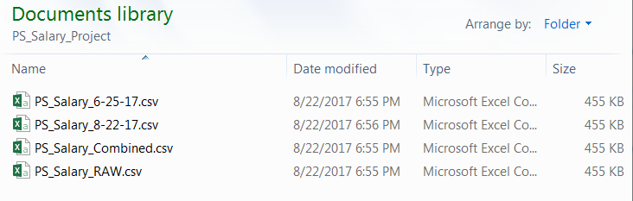
Organizing your data

Slide 14
Organizing your data
Know your “data types”
String or char or varchar
Float or double
Integer
Boolean
Make sure your data is in the correct data type to avoid headaches!
Notes:
String: contains text
Float or double: decimal
Integer: whole number, negative or positive
Boolean: true/false
CAREFUL: zip codes and phone numbers should be strings
CAREFUL: you can’t perform calculations on strings

Slide 15
Basic web scraping
Scraping is the hard way of getting data
Scrapers are sometimes called “extractors”
Scrapers are sometimes called “crawlers”
Notes:
This webpage doesn’t have a download link and gets all messed up when you try to copy and paste it in Excel:
http://www.abc.ca.gov/datport/SubMthRevRep.asp
Another example: https://en.wikipedia.org/wiki/List_of_parishes_in_Louisiana
Right click on page → view source → scroll through the HTML. Scraping means extracting the right HTML and telling your program where to put it.
=importHTML(“URL”, “query”, index)
Any time the website changes, the changes show up in your spreadsheet
See a webpage’s XML in Chrome by clicking View > Developer > Developer Tools

Slide 16
Basic web scraping
The basics
HTML is wrapped in tags that look like:
<> content content </>
<table> table information here </table>
To extract data in a google spreadsheet:
=ImportHTML(“URL”, “element”, NumberElement)
Notes:
HTML is under the hood of websites, right click and “view source” in your browser, it’s what computers are seeing

Slide 17
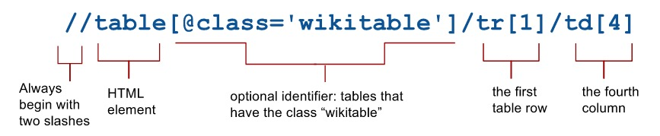
Basic web scraping
A little less basic with XML and XPaths
=importXML(“URL”, “XPath”)
Notes:
https://en.wikipedia.org/wiki/List_of_parishes_in_Louisiana
=importXML("https://en.wikipedia.org/wiki/List_of_parishes_in_Louisiana","//table[3]/tr[1]")
See a webpage’s XML in Chrome by clicking View > Developer > Developer Tools
Instead of scraping a whole table, you’re scraping parts of the table, so you have to use something called XPath
o Works like a URL: The address starts big and then goes small to tell you where you are in the code
o Right click > copy > copy XPath and add to formula below
o If there’s an error, that’s because you have to delete the part in the brackets because that’s extra information
· You can scrape everything at a particular XPath using this Google Sheets formula:
o =importXML(“source”, “XPath”)
Case # 2: IMPORTXML(url cell reference,”all the h2 headers in the page”) --> =importXML(“URL”, “//h2”)

Slide 18
Basic web scraping
Scrape an RSS feed easily:
=ImportFeed(“URL”)

Slide 19
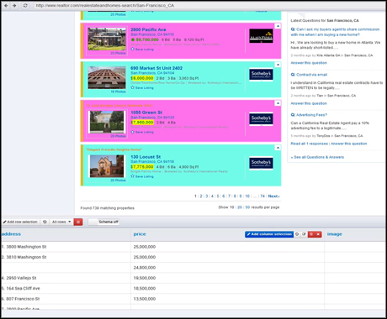
Other web scraping tools
Import.io
Notes:
Give it a URL and it will show you what’s on the page
Then point to the parts on the page you want it to extract and tell it what cells you want to put the data in
· Import.io is a desktop app with a “magic” function that scrapes static webpages. It’ll probably work on a simple webpage like with HTML tables. Not much troubleshooting, unfortunately, but some if you know XPath (manually build an extractor). Also let’s you build crawlers! BUT each data point must have the same XPath or it won’t work.
o You can also create a “connector” where you record yourself on the webpage (a “macro”) and it repeats it as often as necessary
o Free service for data journalists where they will do things for you, but not sure what terms of service are
Other good tools: DownThemAll (Firefox add on), Zapier (website), IFTTT (website), Web Scraper (chrome extension), CloudScrape (web service)
· Power BI: Free tool, download it, “get data” > “from web” > add link

Slide 20
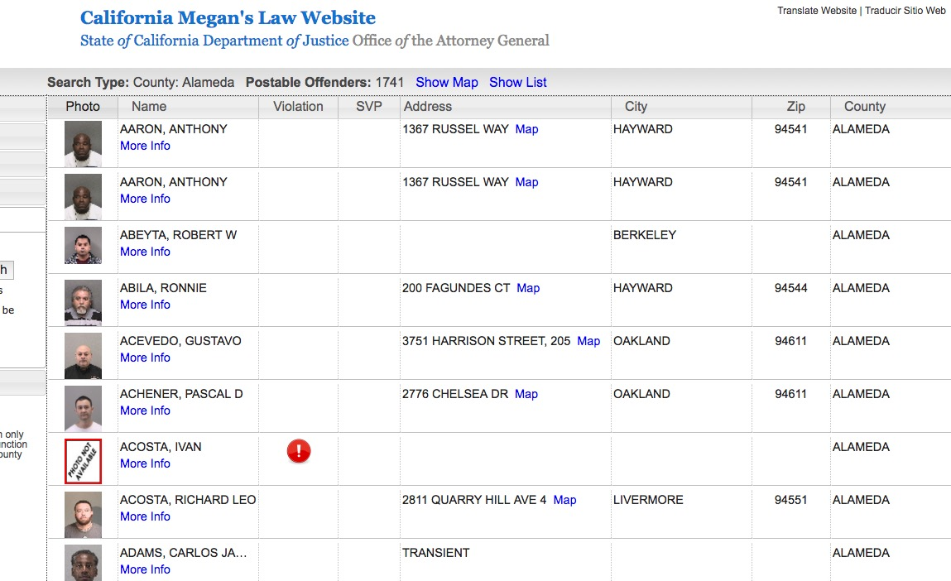
Other web scraping tools
Python
Notes:
https://protect-us.mimecast.com/s/oXpWBaUnVxGJH9?domain=meganslaw.ca.gov
Good if you’re having problems with the URLs
Really good if you have a lot of pages to scrape (a “crawler”)

